Slide 1
Lecture 2: NuMBER SYSTEM COMPUTATION & CODES

Slide 2
Contents
COMPUTATION IN NUMBER SYSTEM
NORMAL ADDITION
BINARY ADDITION, SUBSTRACTION, MULTIPLICATION
COMPLEMENT’S INTRODUCTION
SIGNED BINARY NUMBERS
COMMON CODES
BCD (BINARY CODED DECIMAL) CODE
GREY CODE
ASCII CODE
ERROR DETECTING CODE

Slide 3
Normal Addition
Decimal Addition
1
1
Carry
5
5
+
5
5
1
1
0
= Ten ≥ Base
➔ Subtract a Base

Slide 4
Binary Addition
Column Addition
1
1
1
1
1
1
1
1
1
1
0
1
= 61
= 23
+
1
0
1
1
1
1
0
1
0
1
0
0
= 84
≥ (2)₁₀

Slide 5
Binary Subtraction
Borrow a “Base” when needed
1
2
= (10)₂
0
2
2
0
0
2
1
0
0
1
1
0
1
= 77
= 23
−
1
0
1
1
1
0
1
1
0
1
1
0
= 54

Slide 6
Binary Multiplication
Bit by bit
1
0
1
1
1
x
1
0
1
0
0
0
0
0
0
1
0
1
1
1
0
0
0
0
0
1
0
1
1
1
1
1
1
0
0
1
1
0

Slide 7
Complements Introduction
There are two types of complements for each base-r system: the radix complement and diminished radix complement.
Diminished Radix Complement - (r-1)’s Complement
Given a number N in base r having n digits, the (r–1)’s complement of N is defined as:
(r^{n} –1) – N
Example for 6-digit decimal numbers:
9’s complement is (r^{n} – 1)–N = (10⁶–1)–N = 999999–N
9’s complement of 546700 is 999999–546700 = 453299

Slide 8
Complements Introduction (CONT.)
Example for 7-digit binary numbers:
1’s complement is (r^{n} – 1) – N = (2⁷–1)–N = 1111111–N
1’s complement of 1011000 is 1111111–1011000 = 0100111
Observation:
Subtraction from (r^{n} – 1) will never require a borrow
Diminished radix complement can be computed digit-by-digit
For binary: 1 – 0 = 1 and 1 – 1 = 0

Slide 9
Complements INTRODUCTION (Cont.)
1’s Complement (Diminished Radix Complement)
All ‘0’s become ‘1’s
All ‘1’s become ‘0’s
Example (10110000)₂
⇨ (01001111)₂
If adding a number and its 1’s complement …
1 0 1 1 0 0 0 0
+ 0 1 0 0 1 1 1 1
1 1 1 1 1 1 1 1

Slide 10
Complements (cont.)
Radix Complement
Example: Base-10
Example: Base-2
The r's complement of an n-digit number N in base r is defined as
r^{n} – N for N ≠ 0 and as 0 for N = 0. Comparing with the (r − 1) 's complement, we note that the r's complement is obtained by adding 1 to the (r − 1) 's complement, since r^{n} – N = [(r^{n} − 1) – N] + 1.
The 10's complement of 012398 is 987602
The 10's complement of 246700 is 753300
The 2's complement of 1101100 is 0010100
The 2's complement of 0110111 is 1001001

Slide 11
Complements INTRODUCTION (cont.)
2’s Complement (Radix Complement)
Take 1’s complement then add 1
Toggle all bits to the left of the first ‘1’ from the right
Example:
Number:
1’s Comp.:
OR
1 0 1 1 0 0 0 0
0 1 0 0 1 1 1 1
+ 1
0 1 0 1 0 0 0 0

Slide 12
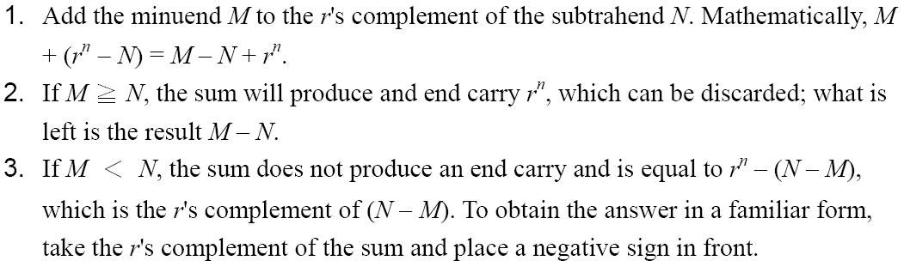
Complements INTRODUCTION (cont.)
Subtraction with Complements
The subtraction of two n-digit unsigned numbers M – N in base r can be done as follows:

Slide 13
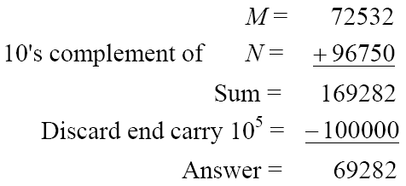
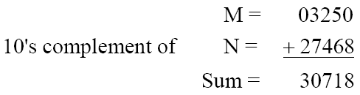
Complements INTRODUCTION (cont.)
Example 1
Using 10's complement, subtract 72532 – 3250.
Example 2
Using 10's complement, subtract 3250 – 72532.
There is no end carry.
Therefore, the answer is – (10's complement of 30718) = − 69282.

Slide 14
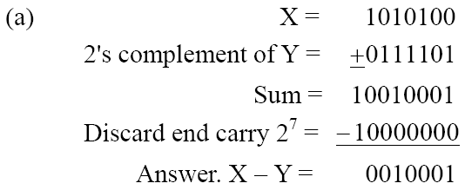
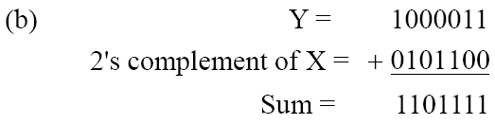
Complements INTRODUCTION (cont.)
Example 3
Given the two binary numbers X = 1010100 and Y = 1000011, perform the subtraction (a) X – Y ; and (b) Y − X, by using 2's complement.
There is no end carry. Therefore, the answer is Y – X = − (2's complement of 1101111) = − 0010001.

Slide 15
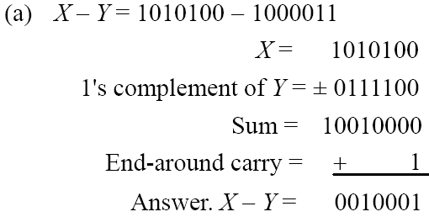
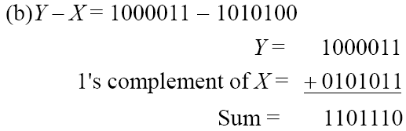
Complements INTRODUCTION (cont.)
Subtraction of unsigned numbers can also be done by means of the (r − 1)'s complement. Remember that the (r − 1) 's complement is one less than the r's complement.
Example 4
Repeat Example 3, but this time using 1's complement.
There is no end carry, Therefore, the answer is Y – X = − (1's complement of 1101110) = − 0010001.

Slide 16
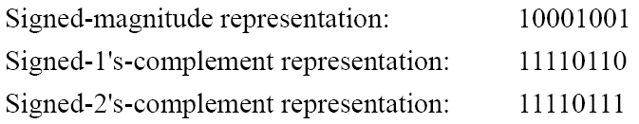
Signed Binary Numbers
In order to represent negative integers, a notation for negative values is required.
It is customary to represent the sign with a bit placed in the leftmost position of the number since binary digits.
The convention is to make the sign bit 0 for positive and 1 for negative.
Example:

Slide 17
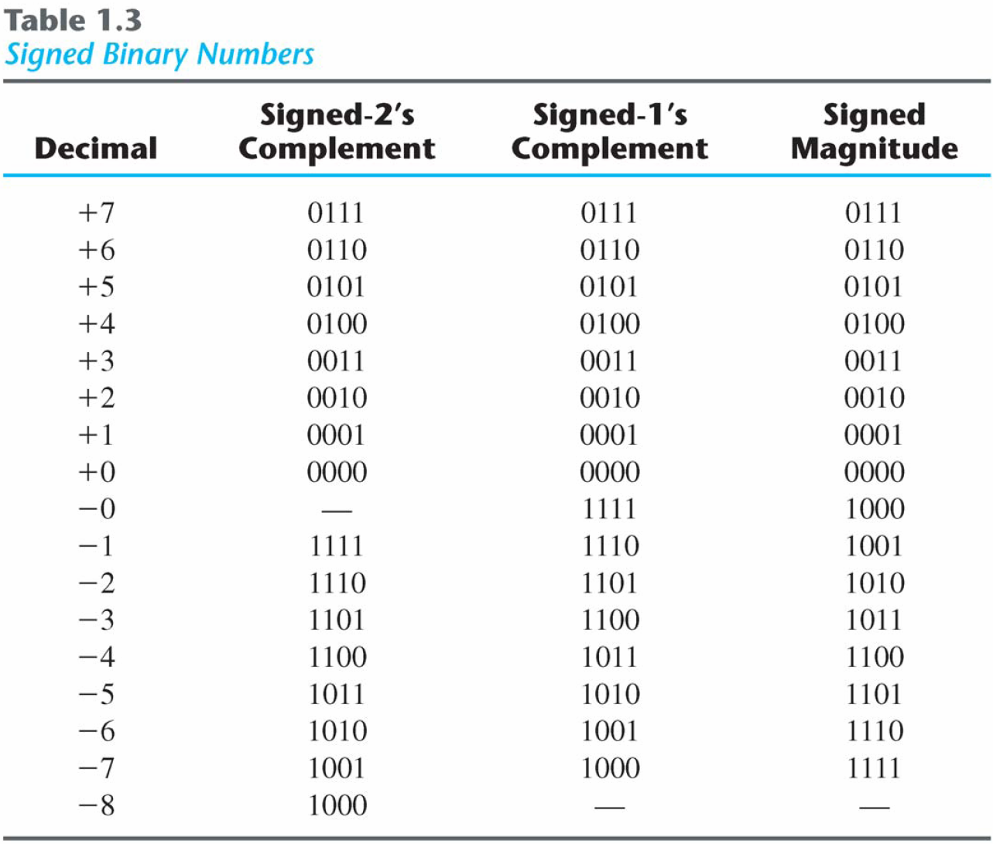
Signed Binary Numbers (cont.)

Slide 18
Signed Binary Numbers (cont.)
Arithmetic addition:
The addition of two numbers in the signed-magnitude system follows the rules of ordinary arithmetic. If the signs are the same, add the two magnitudes and give the sum the common sign. If they are different, subtract the smaller magnitude from the larger and give the difference the sign as the larger magnitude.
The addition of two signed binary numbers with negative numbers represented in signed-2's-complement form is obtained from the addition of the two numbers, including their sign bits.
A carry out of the sign-bit position is discarded.

Slide 19
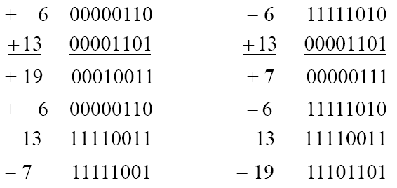
Signed Binary Numbers (cont.)
Example:

Slide 20
Signed Binary Numbers (cont.)
Arithmetic Subtraction
In 2’s-complement form:
Example:
Take the 2’s complement of the subtrahend (including the sign bit) and add it to the minuend (including sign bit).
A carry out of sign-bit position is discarded.
(− 6) − (− 13)
(11111010 − 11110011)
(11111010 + 00001101)
00000111 (+ 7)

Slide 21
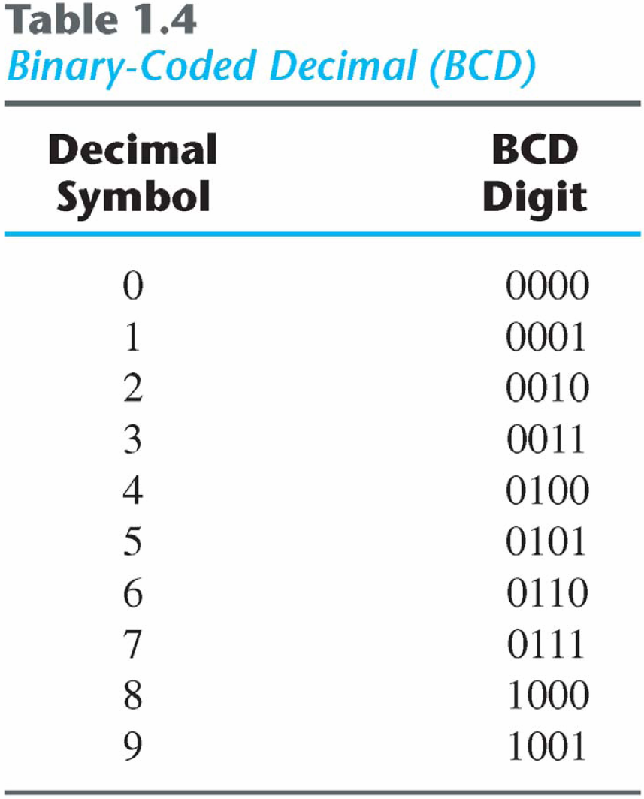
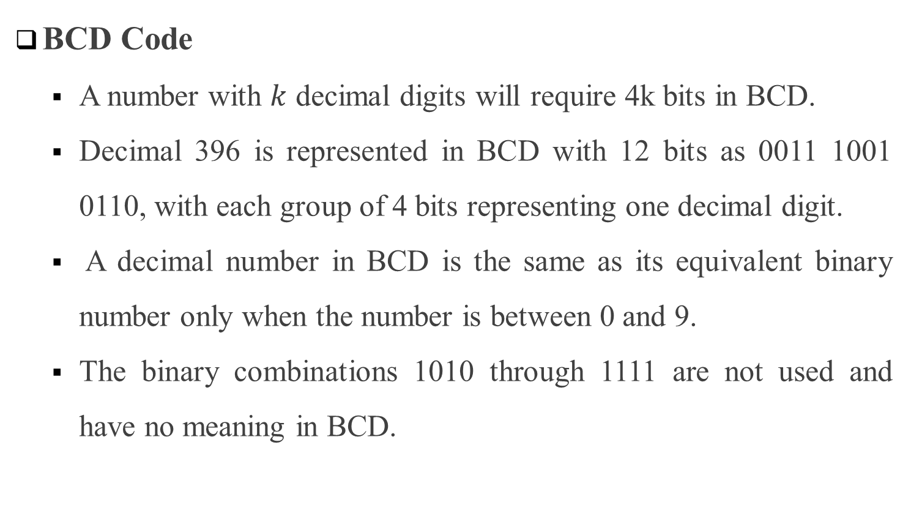
COMMON Codes
BCD Code
A number with $k$ decimal digits will require 4k bits in BCD.
Decimal 396 is represented in BCD with 12 bits as 0011 1001 0110, with each group of 4 bits representing one decimal digit.
A decimal number in BCD is the same as its equivalent binary number only when the number is between 0 and 9.
The binary combinations 1010 through 1111 are not used and have no meaning in BCD.

Slide 22
COMMON Codes (cont.)- BCD Example 1
Consider decimal 185 and its corresponding value in BCD and binary:
BCD addition

Slide 23
COMMON Codes (cont.)- BCD Example 2
Consider the addition of 184 + 576 = 760 in BCD:
Decimal Arithmetic: (+375) + (-240) = +135
Hint for -240: using 10’s of BCD

Slide 24
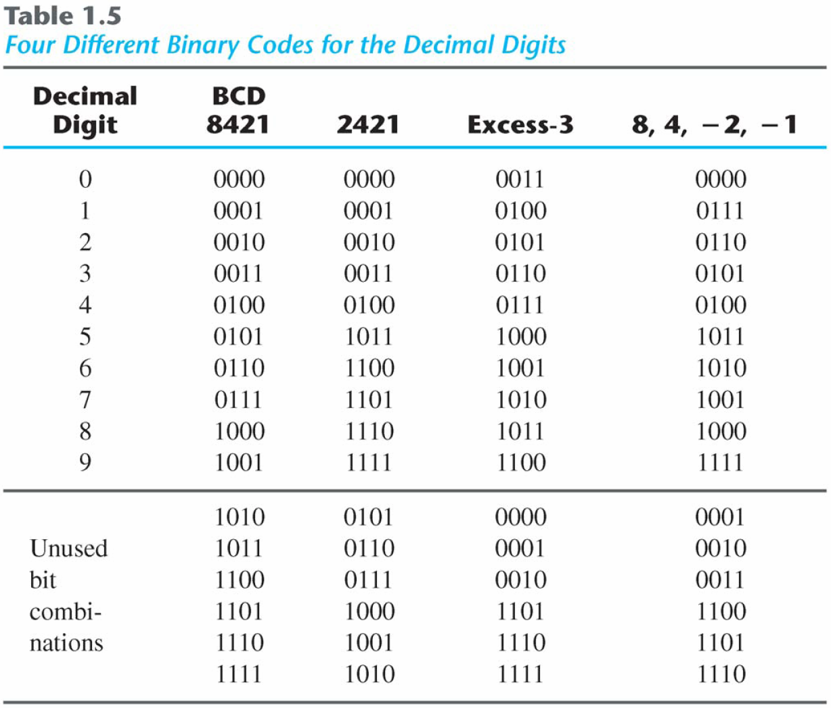
COMMON Codes (cont.)
Other Decimal Codes

Slide 25
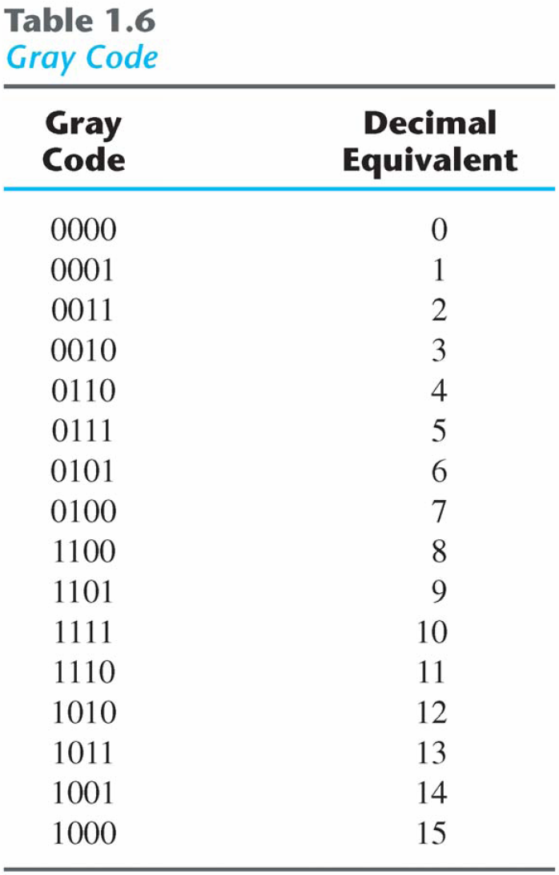
COMMON Codes (cont.)-GREY Code
Gray Code
The advantage is that only bit in the code group changes in going from one number to the next.
Error detection.
Representation of analog data.
Low power design.
000
001
010
011
100
101
110
111
1-1 and onto!!

Slide 26
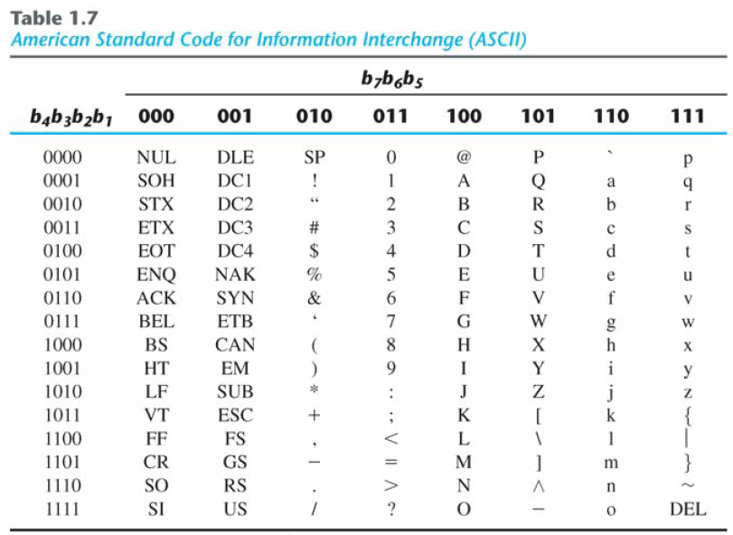
COMMON Codes (cont.)-ASCII Code
American Standard Code for Information Interchange (ASCII) Character Code

Slide 27
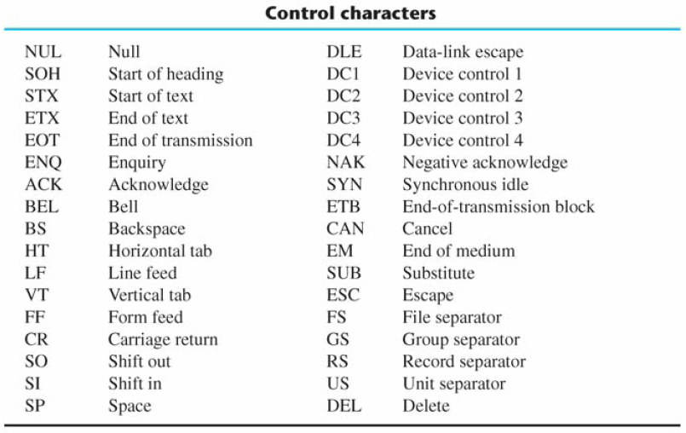
COMMON Codes (cont.)-ASCII Code
ASCII Character Code

Slide 28
COMMON Codes (cont.)-ASCII CHARACTER Code
American Standard Code for Information Interchange (Refer to Table 1.7)
A popular code used to represent information sent as character-based data.
It uses 7-bits to represent:
94 Graphic printing characters.
34 Non-printing characters.
Some non-printing characters are used for text format (e.g. BS = Backspace, CR = carriage return).
Other non-printing characters are used for record marking and flow control (e.g. STX and ETX start and end text areas).

Slide 29
ASCII Properties
ASCII has some interesting properties:
Digits 0 to 9 span Hexadecimal values 30₁₆ to 39₁₆
Upper case A-Z span 41₁₆ to 5A₁₆
Lower case a-z span 61₁₆ to 7A₁₆
Lower to upper case translation (and vice versa) occurs by flipping bit 6.

Slide 30
Error Detecting Code
Error-Detecting Code introduction
To detect errors in data communication and processing, an eighth-bit is sometimes added to the ASCII character to indicate its parity.
A parity bit is an extra bit included with a message to make the total number of 1's either even or odd.
Example:
Consider the following two characters and their even and odd parity:

Slide 31
Error Detecting Code (cont.)
Error-Detecting Code description
Redundancy (e.g. extra information), in the form of extra bits, can be incorporated into binary code words to detect and correct errors.
A simple form of redundancy is parity, an extra bit appended onto the code word to make the number of 1’s odd or even. Parity can detect all single-bit errors and some multiple-bit errors.
A code word has even parity if the number of 1’s in the code word is even.
A code word has odd parity if the number of 1’s in the code word is odd.
Example:
Message A:
10001001
(even parity)
1
Message B:
10001001
(odd parity)
0

Slide 32
Summary
Number System Computation:
Binary mathematical operations: Addition, Multiplication, and Subtraction.
Types of Binary numbers:
Complements
Signed and Unsigned
Mathematical operations for Signed and Unsigned numbers
Common Codes:
BCD code, Grey code, ASCII code, Error Detecting code

